Slide 1
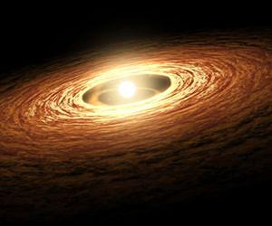
An introduction to the classification, composition, and origin of meteorites
Tadeusz A. Przylibski¹
Andrzej S. Pilski²
¹ - Wrocław University of Technology; Faculty of Geoengineering, Mining and Geology
Institute of Mining Engineering
² – Nicolaus Copernicus Museum in Frombork

Slide 2
EXTRATERRESTRIAL MATTER ON EARTH
prepared by
Randy L. Korotev

Slide 3
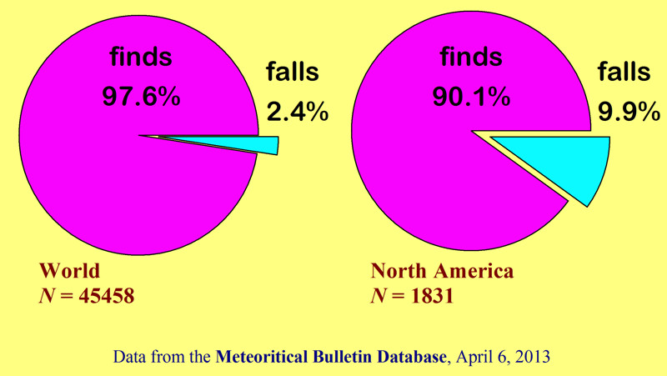
EXTRATERRESTRIAL MATTER ON EARTH
prepared by
Randy L. Korotev

Slide 4
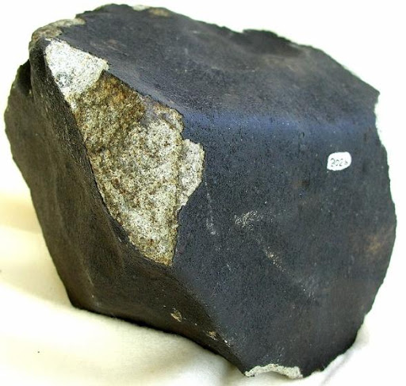
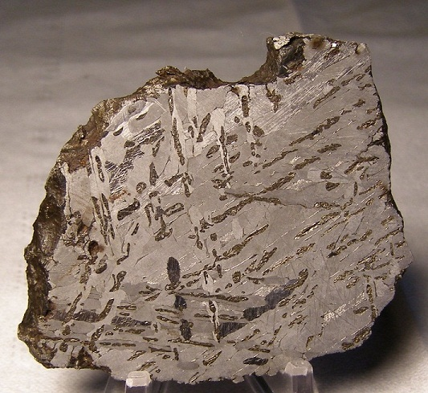
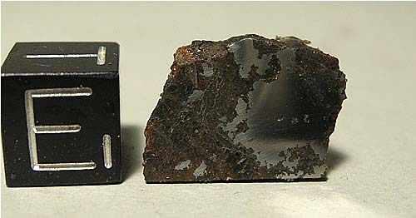
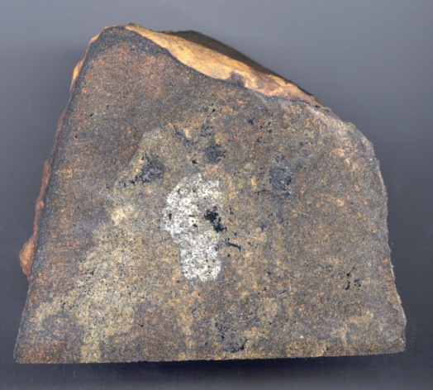
CLASSIFICATION
Morasko
Iron IAB
Pułtusk
Chondrite H5
Łowicz Mesosiderite
Zakłodzie Primitive
Achondrite

Slide 5
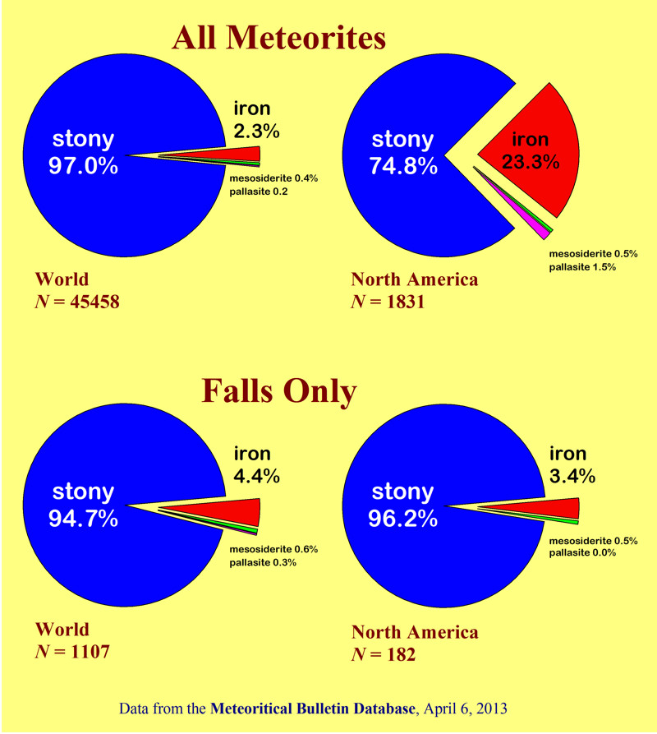
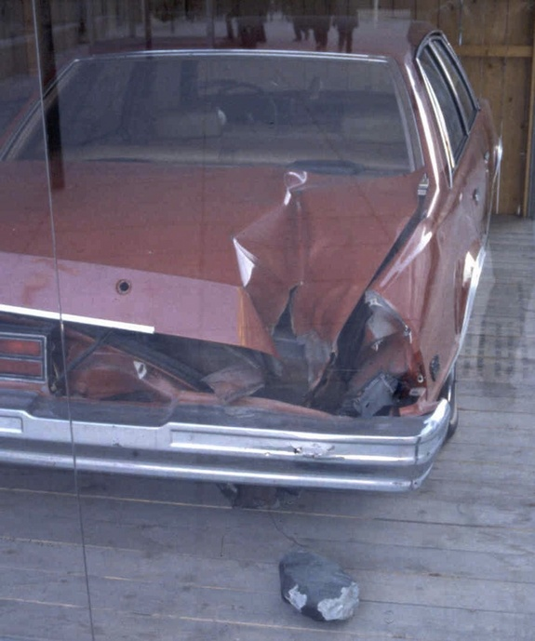
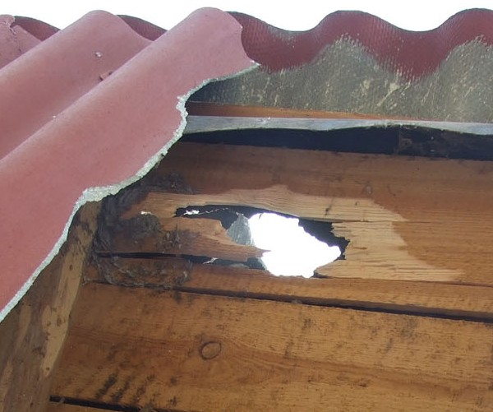
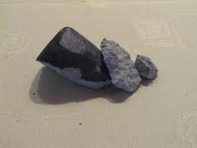
Peekskill (H6)
HAMMER
prepared by
Randy L. Korotev
Sołtmany (L6)

Slide 6
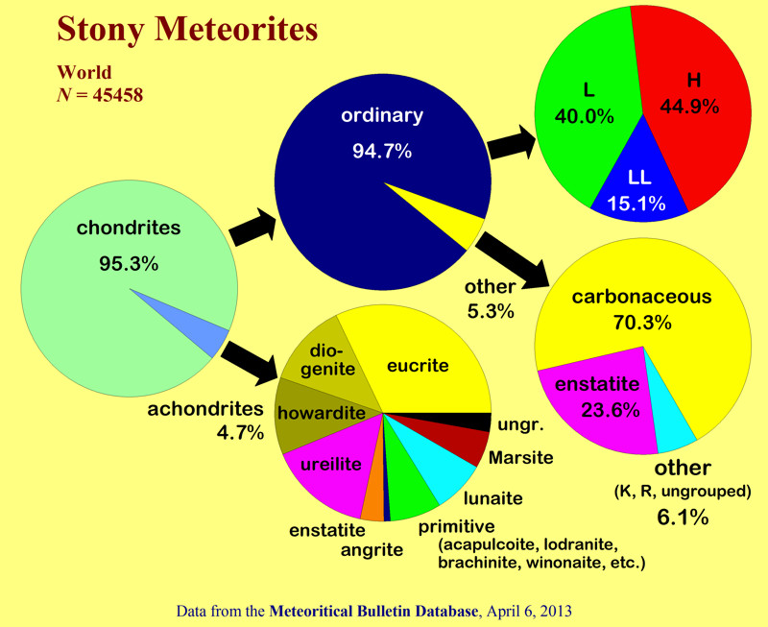
prepared by
Randy L. Korotev

Slide 7
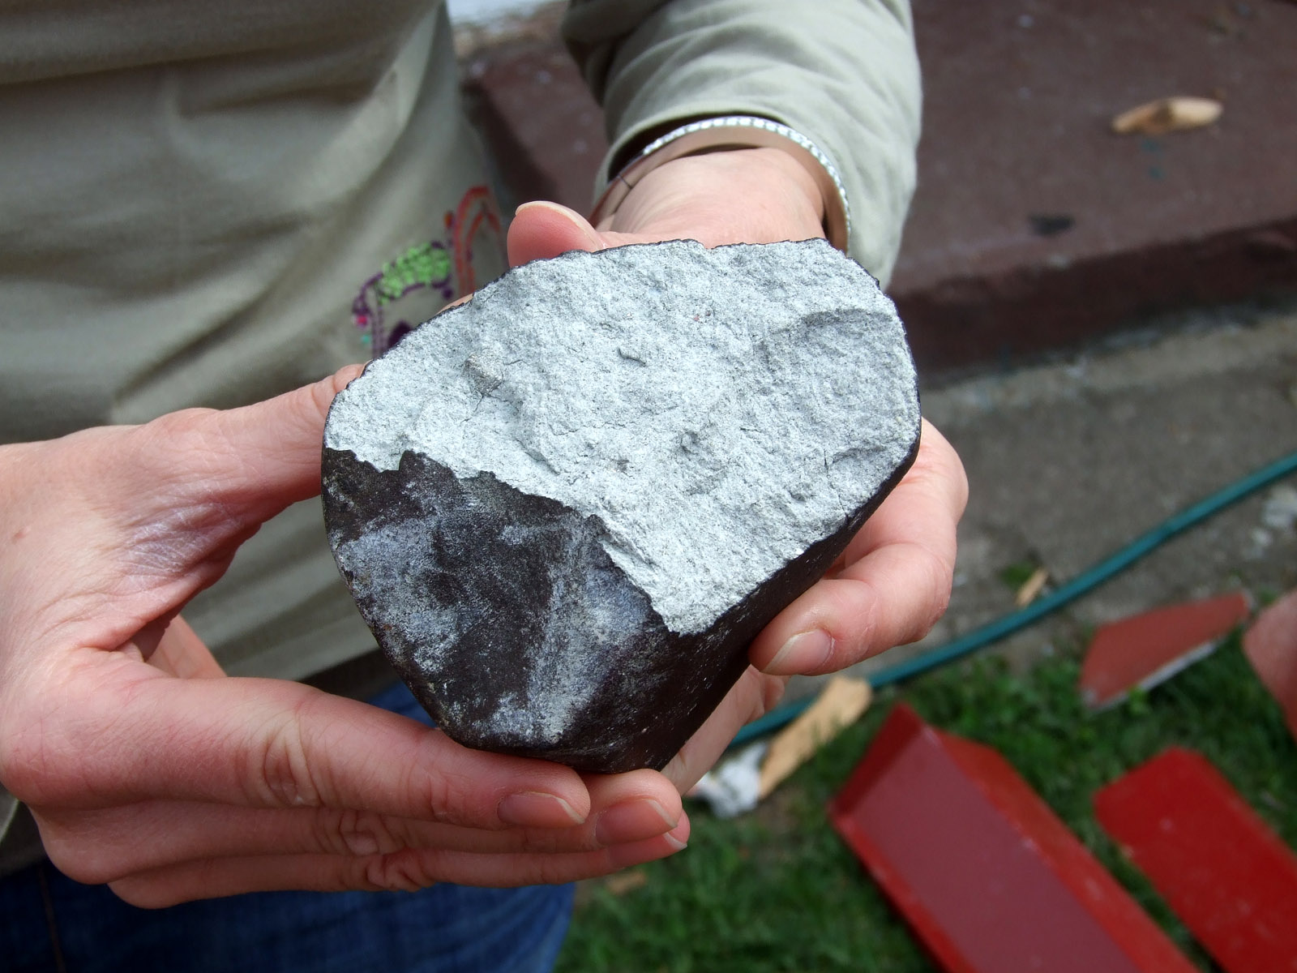
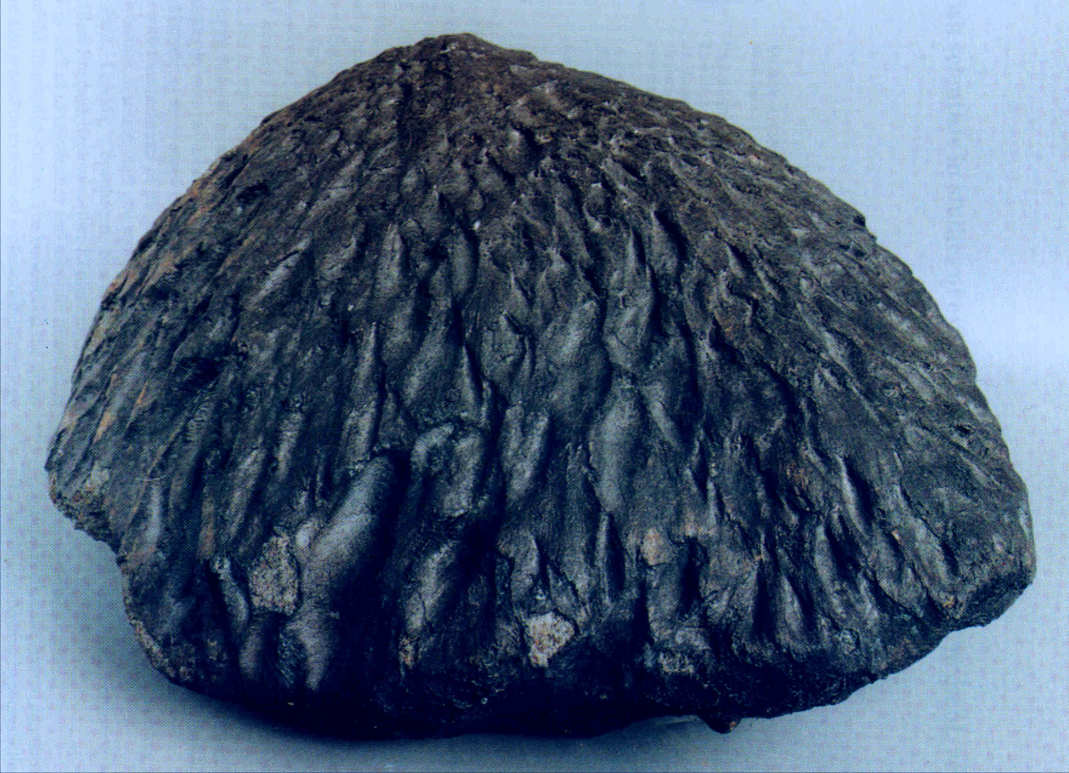
SOŁTMANY
L6
L5
BASZKÓWKA
STONY
METEORITES
CHONDRITES

Slide 8
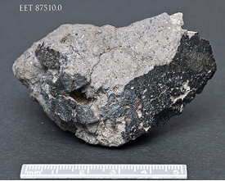
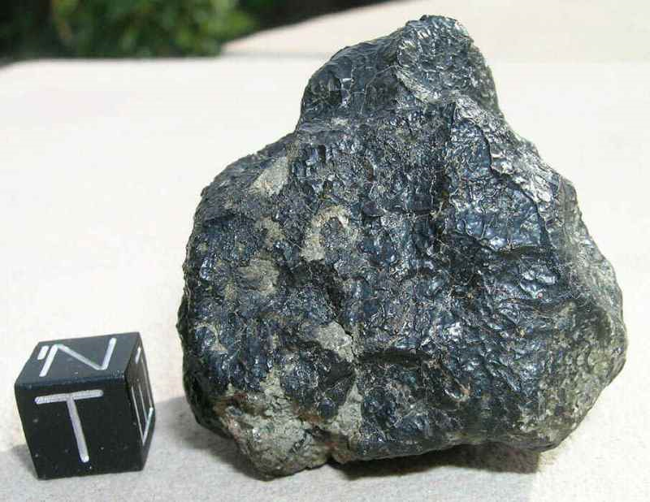
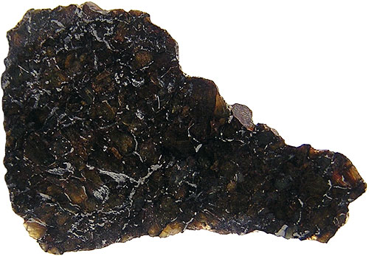
Howardite
NWA 2975
Shergottite
Ureilite Shisr 007
STONY
METEORITES
ACHONDRITES

Slide 9
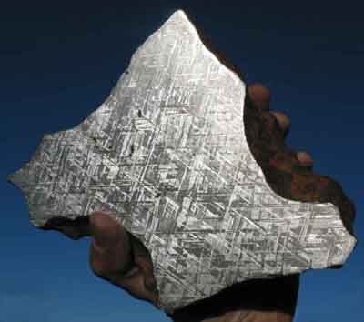
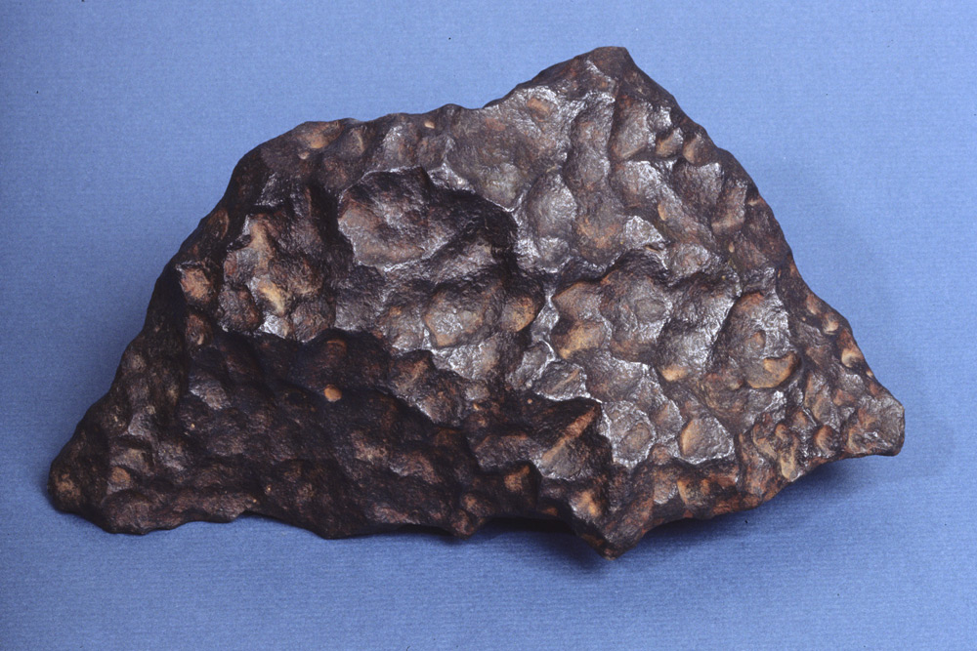
IRON METEORITES
Widmanstatten pattern
(FeNi alloy crystals inter-
growths of different
crystalographical
orientations)

Slide 10
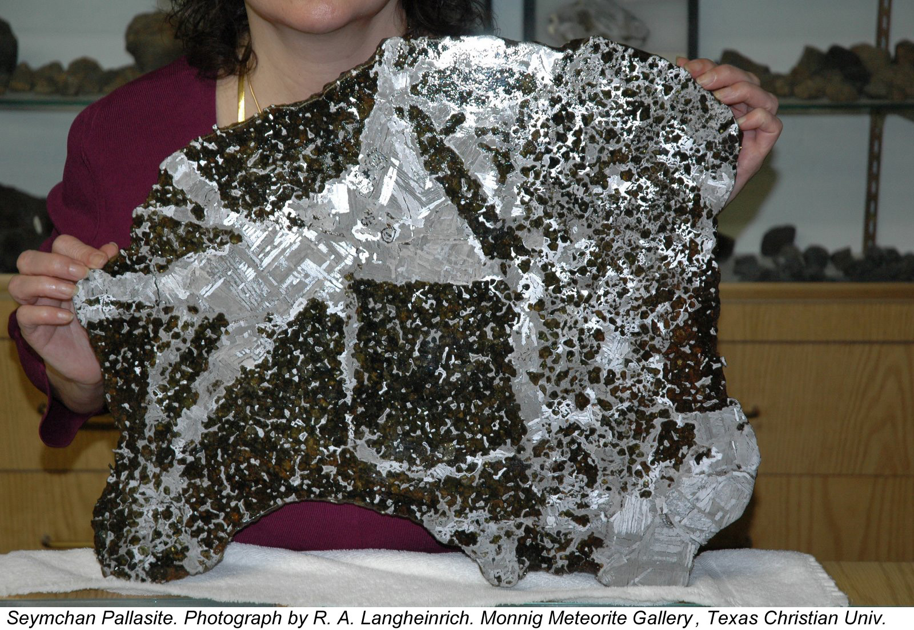
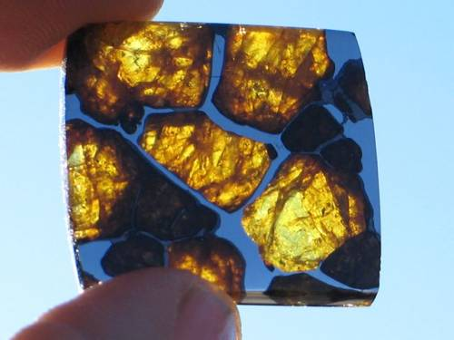
STONY-IRON METEORITES

Slide 11
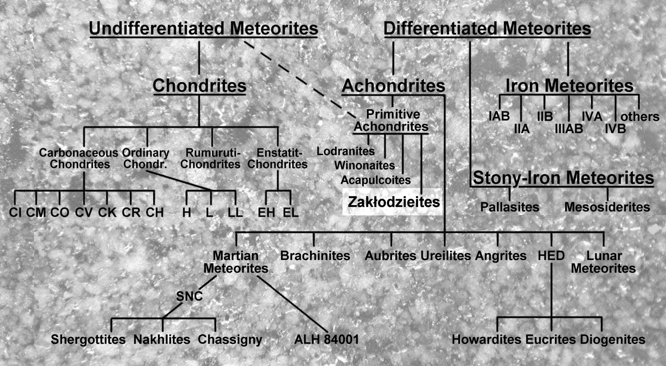
CLASSIFICATION

Slide 12
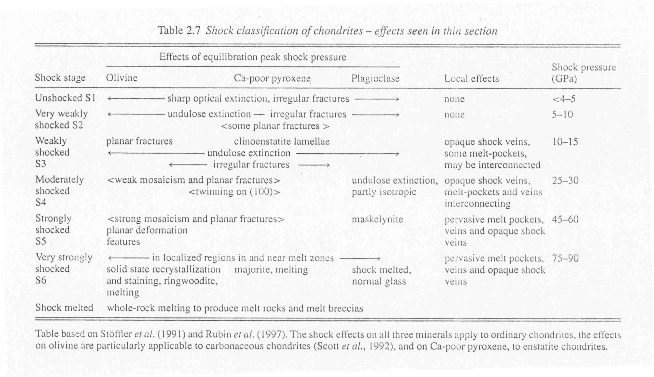
SHOCK STAGES

Slide 13
WEATHERING SCALE
W0: no visible oxidation. Yellow-brown limonitic staining may be seen in transmitted light.
This is common in observed falls, but some may have gone to W1.
W1: minor oxide rims around metal and sulfide grains; minor oxide veins.
W2: about 20 − 60 vol.% metal grains affected by oxidation; veining with Fe oxides are
common.
W3: heavy oxidation; 60 − 95% of metal and sulfide grains replaced by oxides.
W4: complete (>95%) oxidation of metal and sulfide grains; silicates remain unaffected.
W5: mafic silicates slightly altered, mainly along cracks. Olivines tend to alter from within.
W6: massive replacement of silicates by clay minerals and oxides.
It would be nice if meteorites want to apply to this scale.

Slide 14
COMPOSITION
Refractory (opaque) minerals:
Transparent minerals:
FeNi alloy (Kamacite, Taenite)
SULFIDES:
Troilite FeS
Niningerite (Mg, Fe, Mn)S
Alabandite α-MnS
Keilite (Fe, Mg)S
Oldhamite CaS
OXIDES:
Chromite FeCr₂O₄
Ilmenite FeTiO₃
PHOSPHIDES:
Schreibersite (Fe, Ni)₃P
Barringerite (Fe, Ni)₂P
SILICATES:
Pyroxene (Opx, Cpx)
Olivine
Feldspar (Plagioclase)
SiO₂ polimorphs
Silicate glass
Sinoite Si₂N₂O
Diamond C
Halite NaCl
Apatite group
Calcite CaCO₃
Graphite C
Gypsum Ca[SO₄] 2H₂O
Cohenite Fe₃C

Slide 15
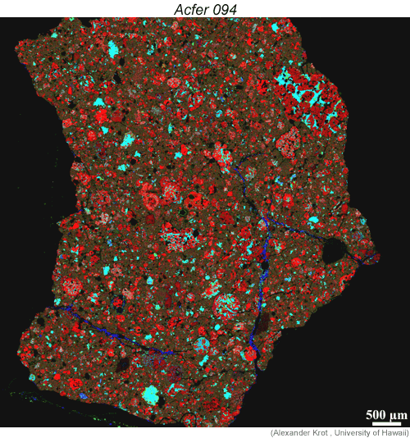
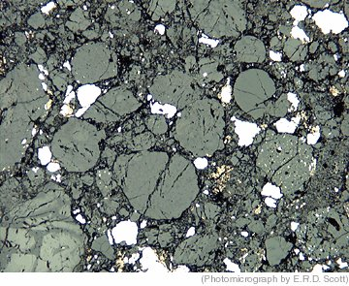
Chondrite Components
Chondrules
Calcium-Aluminum Inclusions (CAI’s)
Amoeboid olivine aggregates AOA’s
Fe-Ni alloy
Fine-grained matrix

Slide 16
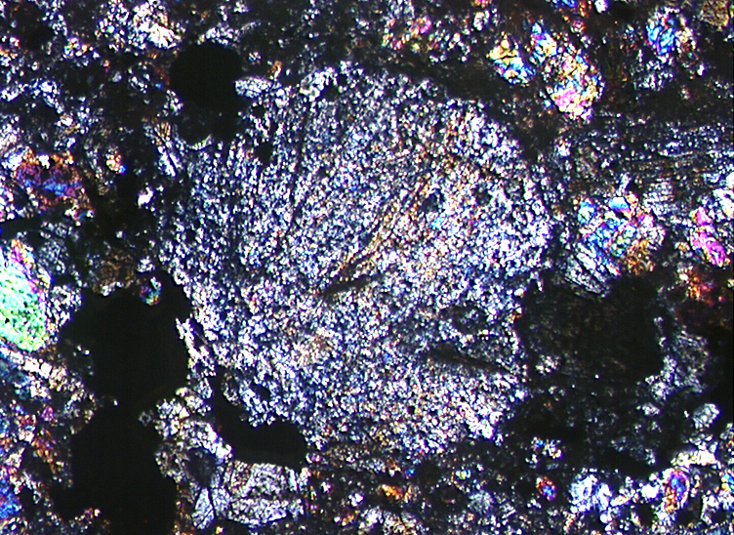
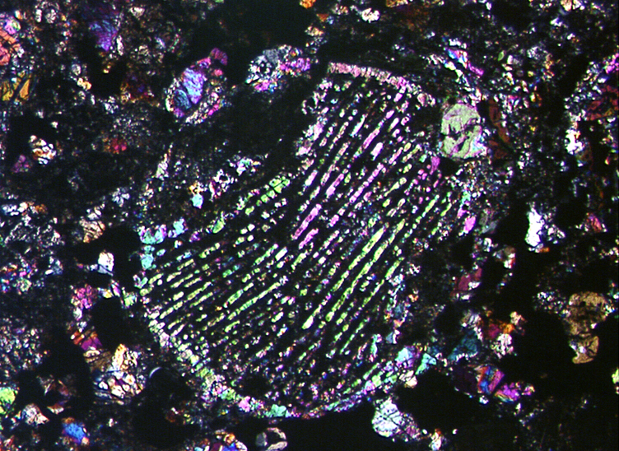
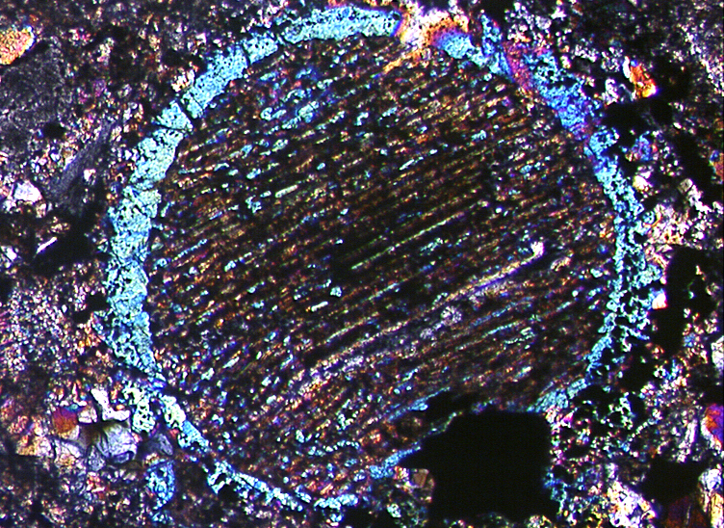
CHONDRULES (~60 VOL. %):
Diameters 0,23 - 1,86 mm
Radial (Px),
Barred (Ol),
Porphyric (Ol, Px),
Granular (Ol, Px),
Glassy
Accretion rims (Ol)

Slide 17
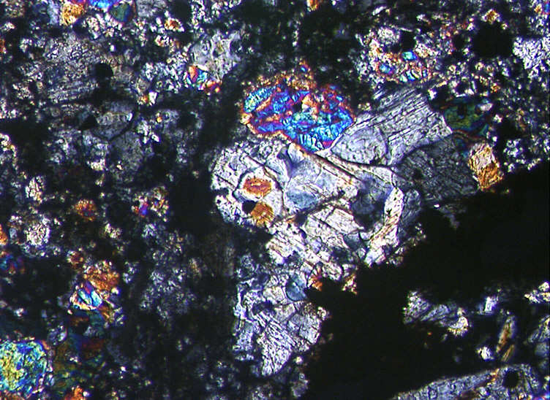
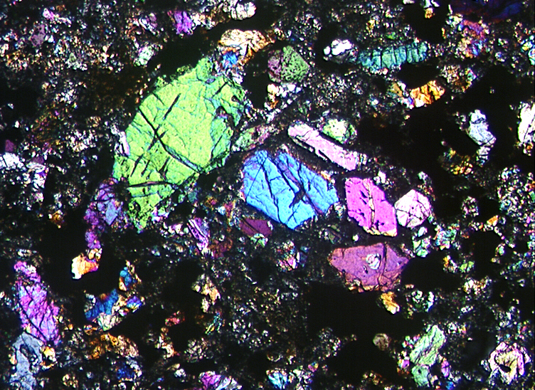
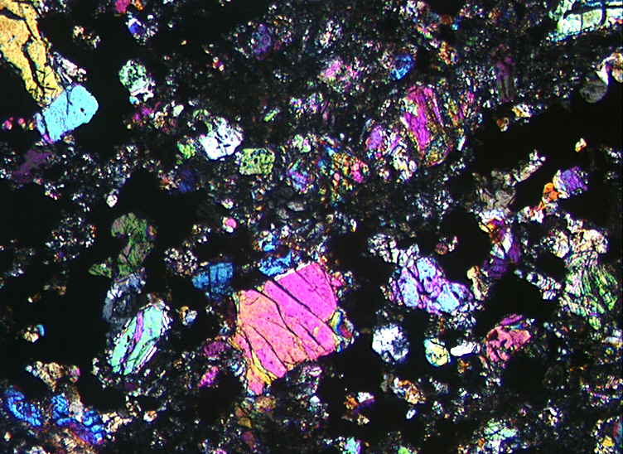
MATRIX (~15 vol. %):
Ol, Px, Fsp
Opaque minerals
(kamacite, taenite, troilite, chromite),
glass

Slide 18
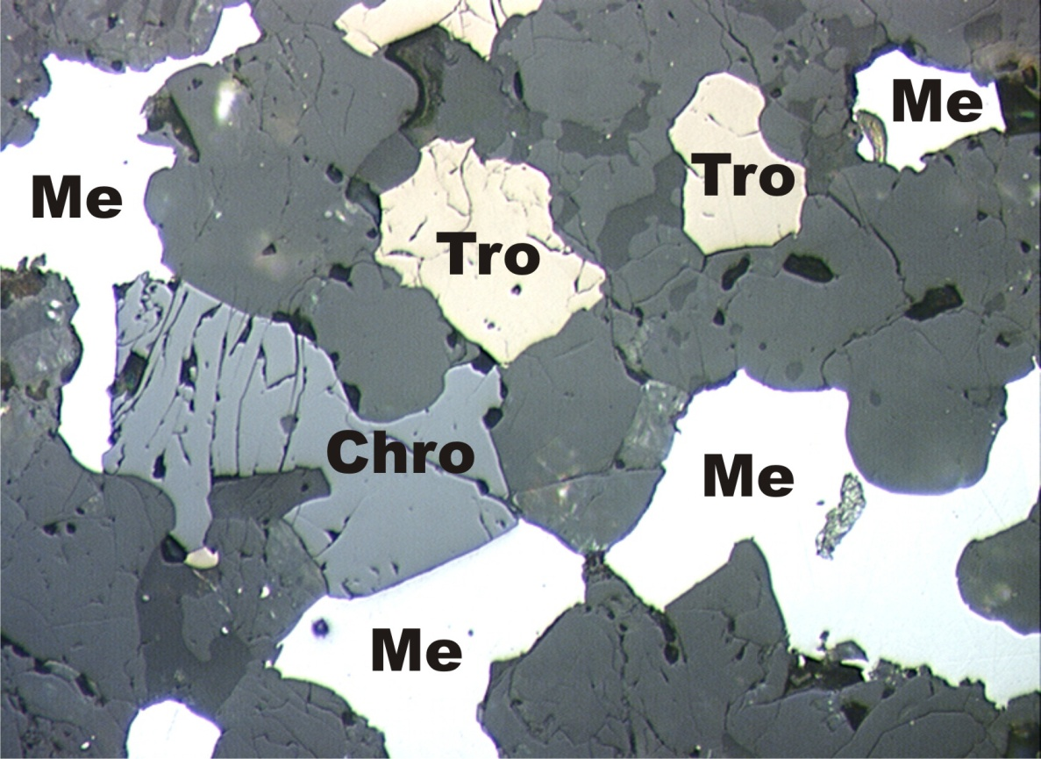
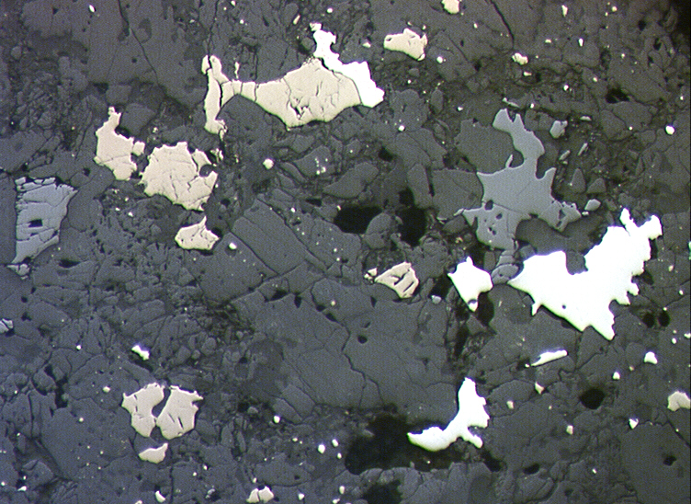
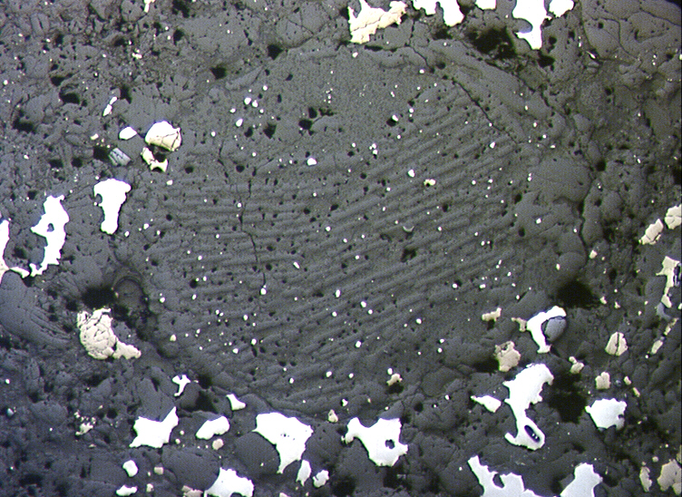
OPAQUE MINERALS (~8 VOL. %)
Me – metal (FeNi alloy)
Tro – troilite (FeS)
Chro – chromite (FeCr₂O₄)

Slide 19
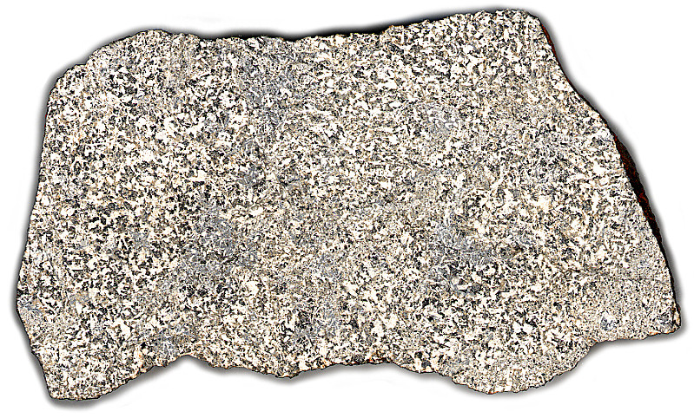
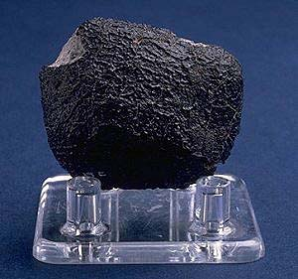
ACHONDRITES (from DIFFERENTIATED BODIES)
HOWARDITES
EUCRITES
DIOGENITES
from VESTA asteroid
NAKHLITES
SHERGOTTITES
CHASSIGNITES
from MARS
PRIMITIVE
ACHONDRITES
ACAPULCOITES
WINONAITES
BRACHINITES
from ???
BASALTS
ANORTHOSITES
from the MOON
Mercury???

Slide 20
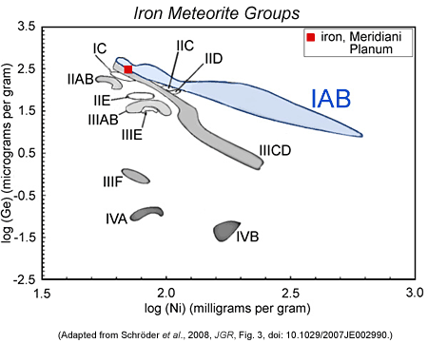
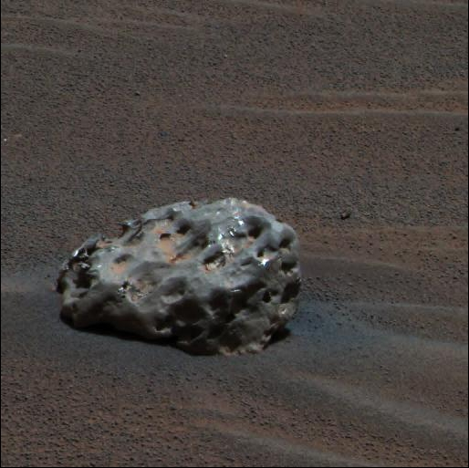
Meteorite on Mars

Slide 21
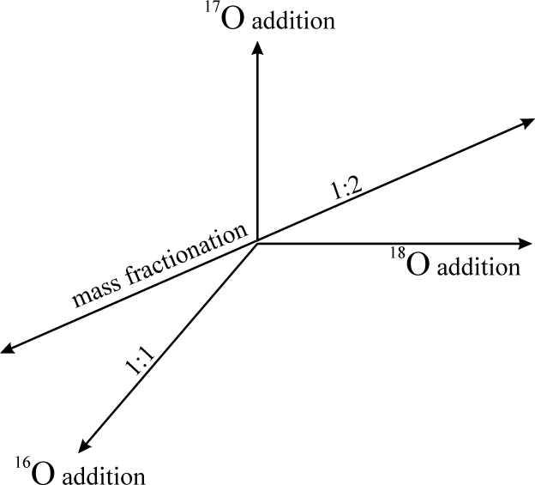
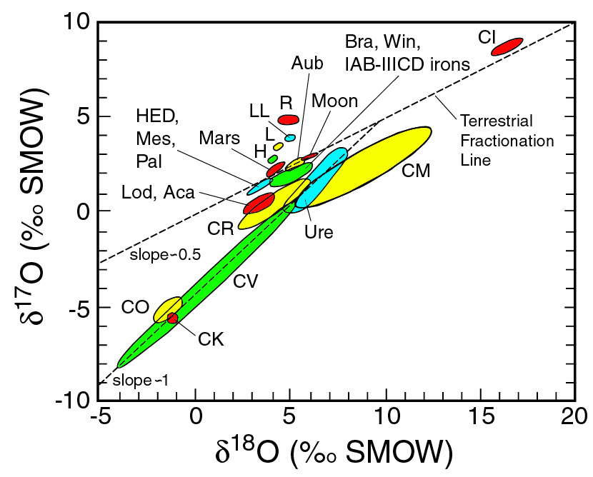
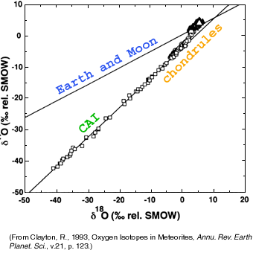
Oxygen Isotopes
gas
dust

Slide 22
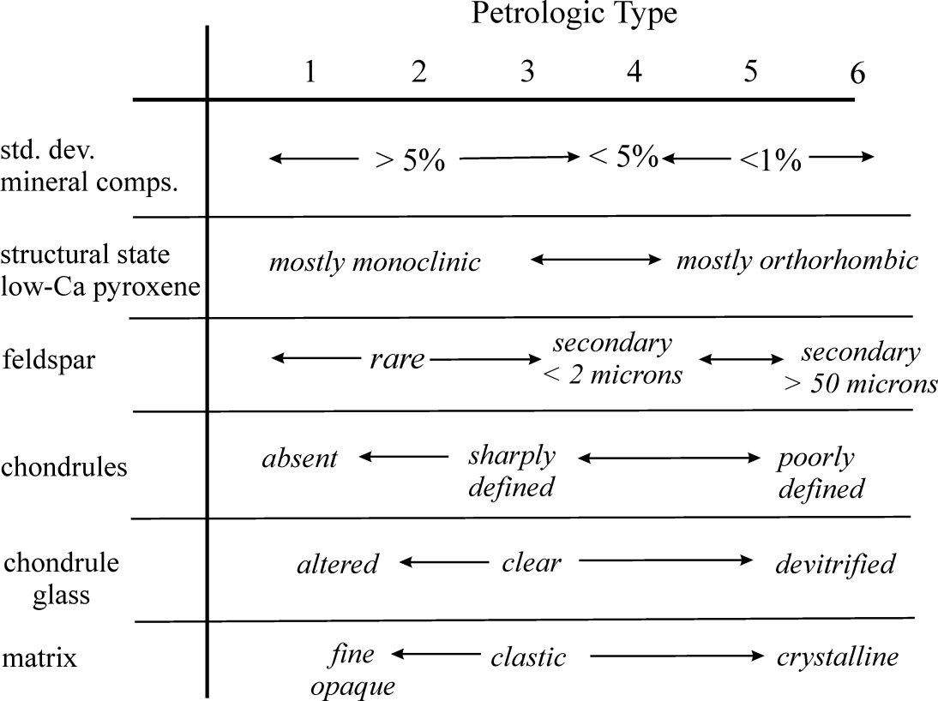
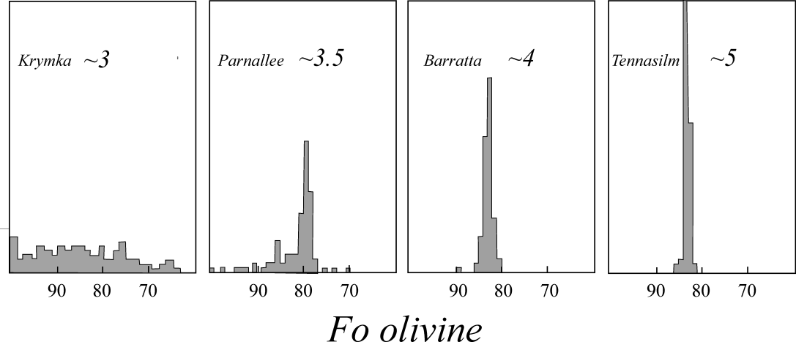
Textural Classification
The chondrite meteorites are further subdivided into petrologic types according to a numeric scale (1 through 6) that reflects the extent of post-formation 'metamorphism' or 'alteration' processes they have experienced:
Type 3 meteorites are characterized by the best preserved chondrules and refractory inclusions, the presence of clear igneous glass, opaque matrices, and highly variable, un-equilibrated silicate mineral compositions. These are thought to represent the most pristine samples of the solar nebula condensate.
Types 2 through 1 are characterized by increasing degree of replacement of anhydrous silicate phases by hydrated phyllosilicates, a greater abundance of volatile elements, an absence of metallic iron, and the destruction of chondrules. These meteorites are thought to have suffered low temperature alteration or weathering in the presence of water.
Types 4 through 6 correspond to an increasing degree re-equilibration reflecting post formation heating to temperatures on the order of 1300oC. They are characterized by relatively equilibrated mineral compositions, lower concentrations of volatile elements, crystalline matrices containing feldspar, and poor preservation of chondrules. This metamorphism is thought to have occurred in small planetesimals such as asteroids. Higher temperatures would lead to partial melting.

Slide 23
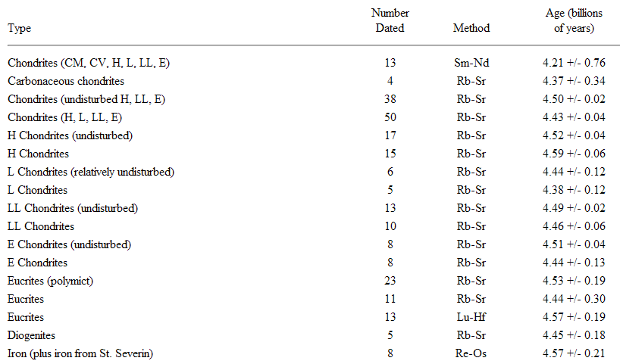
AGES
Chondrite meteorites range in age from ~4.4 to 4.5⁺ Ga, and are the oldest 'rocks' that have ever been dated. The ages of the chondritic meteorites are thus taken as the age of the solar system and the upper limit for the accretion of the Earth. CAI inclusions (4.567 Ga) appear to be slightly older (~2 ma) than the chondrules found in the same chondrite meteorite.

Slide 24
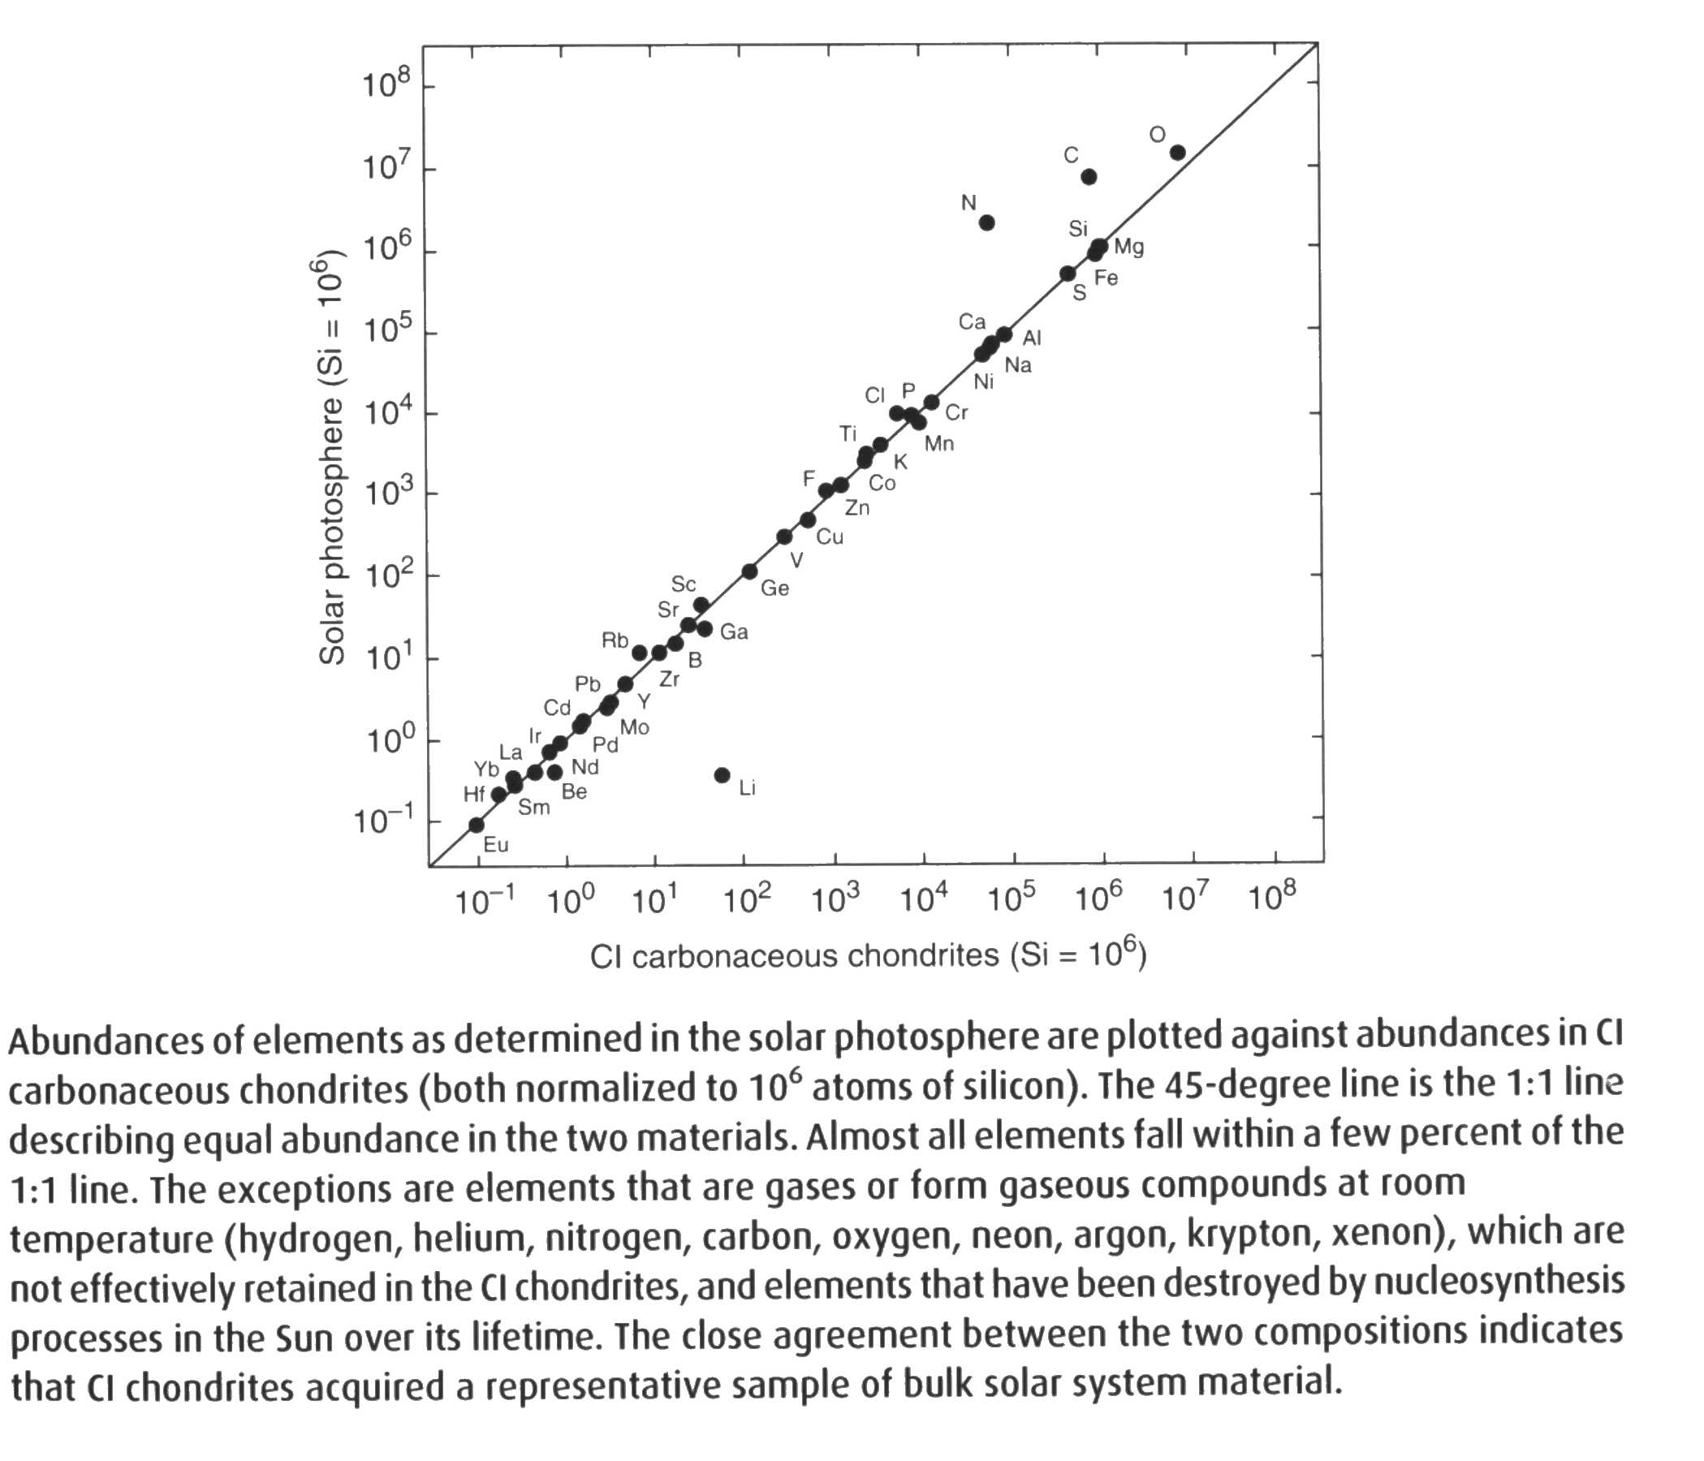
ORIGIN

Slide 25
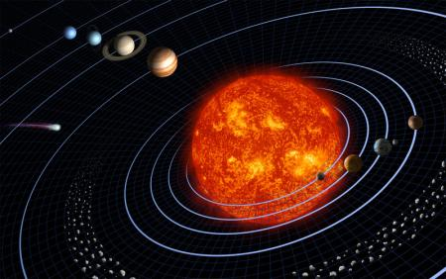
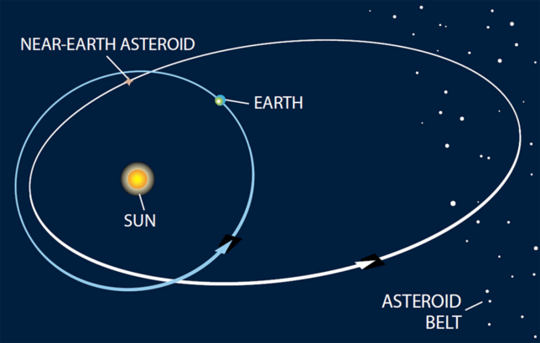
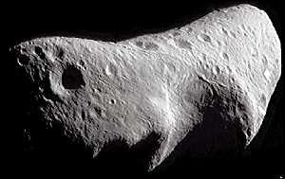
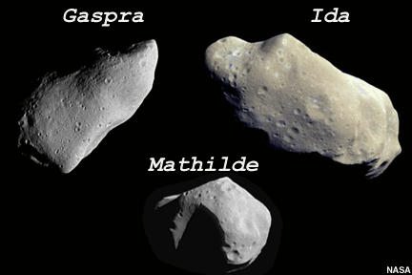
ORIGIN
H chondrites:
6 Hebe
LL chondrites:
433 Eros,
25 143 Itokawa

Slide 26
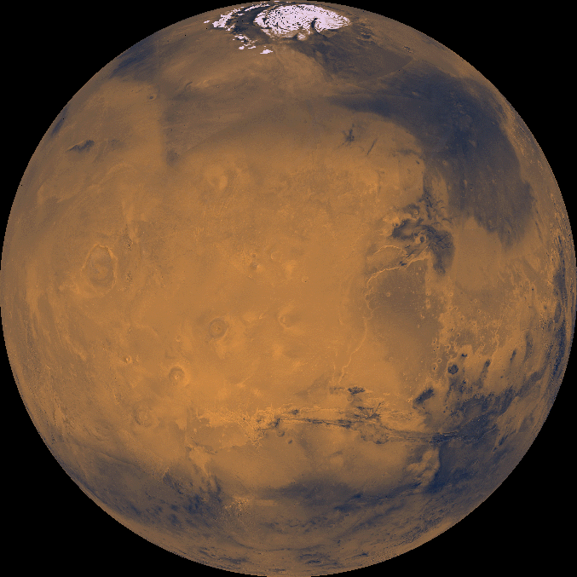
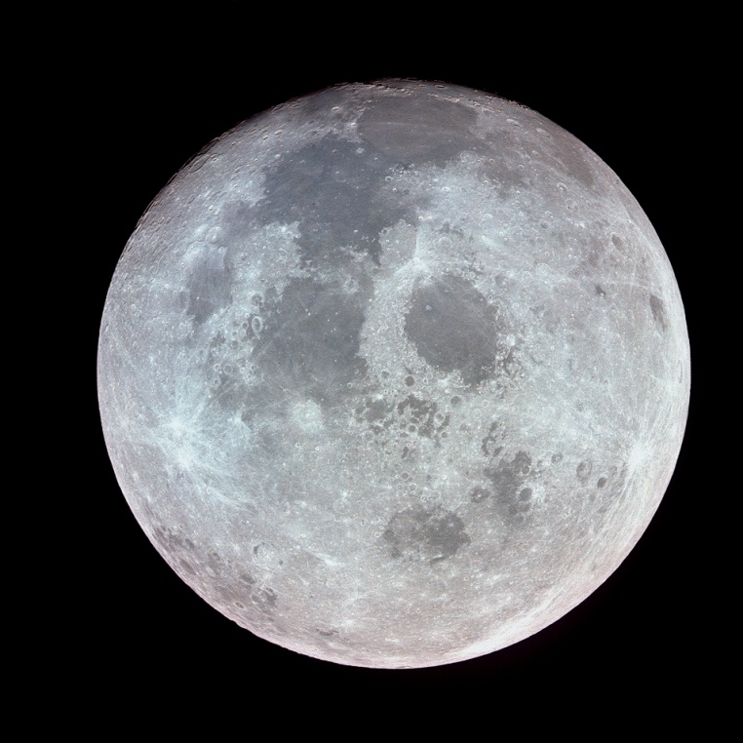
MARS
MOON
4 VESTA
433 EROS
6 HEBE
25 143 ITOKAWA

Slide 27
Types | major mineral phases |  | possible meteorites
M | metal +/- enstatite hydrated silicates+ organics? |  | iron meteorites enstatite chondrites
S | S (I) | Ol >>> Px (+/- FeNi metal) | pallasites, Px-poor ureilites, Px-poor brachinites, olivine-metal partial melt residues
 | S (II) | Ol>> CPx (+/- FeNi metal), (0,05 < CPx/(Ol+CPx) < 0,20) ^{i} | CPx-bearings ureilites, CPx-bearing brachinites, olivine-CPx cumulate, CPx-bearing pallasites, highly metamorphosed, C-type assemblages
 | S (III) | Ol> CPx + OPx (+/- FeNi metal) ^{iv} | CPx- and Opx-bearing ureilites
 | S (IV) | Ol + OPx (+/- FeNi metal) ^{iv}, (0,20 < OPx/(Ol+OPx) < 0,50) | Opx-bearing ureilites, lodranites, winonaites & IAB iron, H, L, LL chondrites Zakłodzie
 | S (V) | Ol – CPx (+/- Me) ^{iv} | lodranites, CPx-basalt intusions into H-chondrite matrix
 | S (VI) | Ol – OPx (+/- FeNi metal) ^{iv} | siderophyres (Steinbach), lodranites, winonaites & IAB irons, subsolidus-reduced chondrites, anorthosites
 | S (VII) | Px > Ol (+/-) (OPx > CPx) | mesosiderites siderophyres (Steinbach), lodranites, winonaites & IAB irons, CPx-poor mesosiderites, subsolidus-reduced chondrites, anorthosites
Q | Ol + Px (+ Me) |  | ordinary chondrites

Slide 29
Thank you
www.nasa.gov

